Slide 1
Fermi Energy and Fermi Level
Probability of Occupation of Electrons
Dr. Elangovan Elamurugu
iDARE Laboratory, Department of Physics and Nanotechnology, SRMIST

Slide 2
Fermi Energy and Fermi Level
"Fermi Level" is the term used to describe the top of the collection of electron energy levels at absolute zero temperature.
This concept comes from Fermi-Dirac statistics.
Electrons are fermions and by the Pauli exclusion principle cannot exist in identical energy states.
So at absolute zero they pack into the lowest available energy states and build up a "Fermi sea" of electron energy states.
The Fermi level is the surface of that sea at absolute zero where no electrons will have enough energy to rise above the surface.
The concept of the Fermi energy is a crucially important for the understanding of the electrical and thermal properties of solids.
Both ordinary electrical and thermal processes involve energies of a small fraction of an electron volt.
But the Fermi energies of metals are on the order of electron volts. This implies that the vast majority of the electrons cannot receive energy from those processes because there are no available energy states for them to go to within a fraction of an electron volt of their present energy.
Limited to a tiny depth of energy, these interactions are limited to "ripples on the Fermi sea".
At higher temperatures a certain fraction, characterized by the Fermi function, will exist above the Fermi level.
The Fermi level plays an important role in the band theory of solids. In doped semiconductors, p-type and n-type, the Fermi level is shifted by the impurities, illustrated by their band gaps.

Slide 3
Fermi Energy and Fermi Level
Fermi Level and Fermi Energy:
The distribution of energy states in a metal is explained by Fermi –Dirac statistics since it deals with the particles having half integral spin like electrons. Consider that the assembly of electrons as electron gas which behaves like a system of Fermi particles or fermions. The Fermions obeying Fermi –Dirac statistics and Pauli’s exclusion principle.
Fermi Energy:
It is the energy of state at which the probability of electron occupation is ½ at any emperature above 0K. It separates filled energy states and unfilled energy states.
Fermi Level:
The highest energy level that can be occupied by an electron at 0 K is called Fermi energy level It is a level at which the electron probability is ½ at any temperature above 0K.

Slide 4
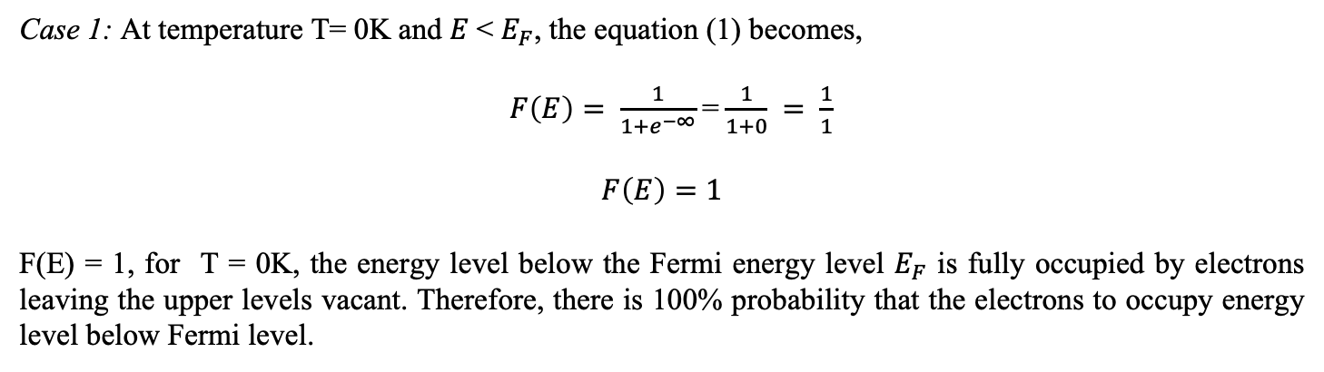
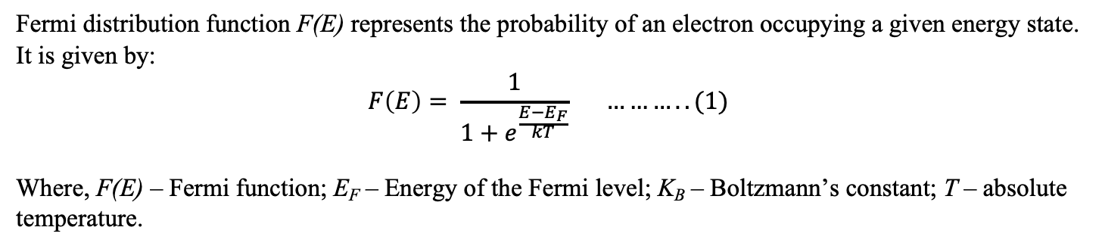
Fermi-Dirac Distribution Function
Fermi distribution function F(E) represents the probability of an electron occupying a given energy state. It is given by:
$$F\left(E\right)= \frac{1}{1+e^{\frac{E−E_{F}}{kT}}} ………..(1)$$
Where, F(E) – Fermi function; E_{F} – Energy of the Fermi level; K_{B} – Boltzmann’s constant; T – absolute temperature.
Case 1: At temperature T= 0K and $E$< $E_{F}$, the equation (1) becomes,
$F\left(E\right)= \frac{1}{1+e^{−∞}}$=$\frac{1}{1+0} = \frac{1}{1}$
$$F\left(E\right)=1$$
F(E) = 1, for T = 0K, the energy level below the Fermi energy level $E_{F}$ is fully occupied by electrons leaving the upper levels vacant. Therefore, there is 100% probability that the electrons to occupy energy level below Fermi level.

Slide 5
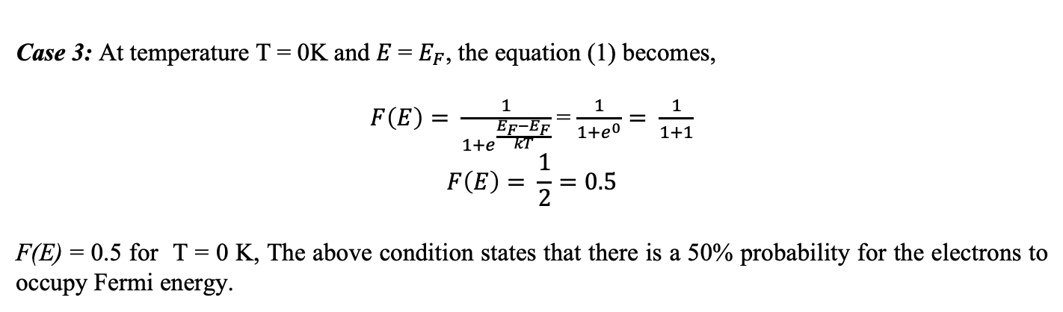
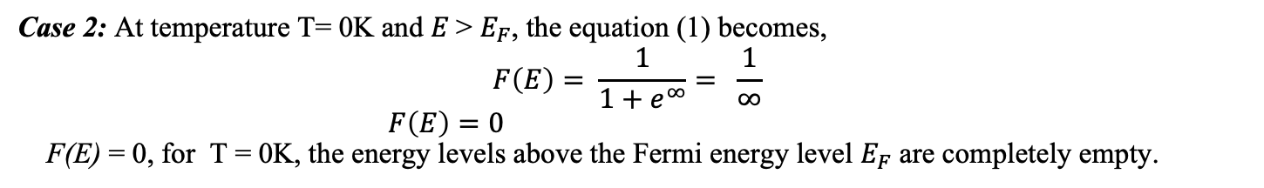
Probability of Occupation of Electrons
Case 2: At temperature T= 0K and $E$> $E_{F}$, the equation (1) becomes,
$$F\left(E\right)= \frac{1}{1+e^{∞}}= \frac{1}{∞}$$
$F\left(E\right)=0$
F(E) = 0, for T = 0K, the energy levels above the Fermi energy level $E_{F}$ are completely empty.
Case 3: At temperature T = 0K and $E$= $E_{F}$, the equation (1) becomes,
$F\left(E\right)= \frac{1}{1+e^{\frac{E_{F}−E_{F}}{kT}}}$= $\frac{1}{1+e^{0}}= \frac{1}{1+1}$
$$F\left(E\right)= \frac{1}{2}=0.5$$
F(E) = 0.5 for T = 0 K, The above condition states that there is a 50% probability for the electrons to occupy Fermi energy.

Slide 6
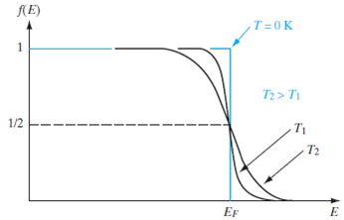
Probability of Occupation of Electrons
At T > 0 K, some levels above Fermi level are partially filled and some levels below Fermi level are partially empty.

